Slide 1
Biol 7200: Programming for Bioinformatics Introduction to unix and bash

Slide 2
Schedule for today
Introductions
Course structure
Unix systems and the command line
Linux filesystem

Slide 3
Schedule for today
Introductions
Course structure
Unix systems and the command line
Linux filesystem

Slide 4
professor and teaching assistants for the class
The instructor for this class is Dr. Alan Collins
The TAs for this class are Haojun Song and Daniel Groves
Questions or office hours by appointment
Alan Collins biol7200.gt@gmail.com
Haojun Song HSong343@gatech.edu
Daniel Groves Dgroves6@gatech.edu

Slide 5
What is bioinformatics?
Bioinformatics is “the collection, classification, storage, and analysis of biochemical and biological information using computers…” – Merriam Webster
“Bioinformatics… is a scientific subdiscipline that involves using computer technology to collect, store, analyze and disseminate biological data…” – National Institute of Health National Human Genome Research Institute
Notes:
MW sounds pretty vague, right? Perhaps some major bioinformatics organizations offer more specific definitions? NOPE!!!

Slide 6



Bioinformatics is a broad field
Biological expertise
Computational expertise
Notes:
As an intro to bioinformatics course (not an intro Bio course) we’re more focused on moving you along the x axis of this plot

Slide 7
Purpose of the class
To give you a foundation in bioinformatics by introducing you to:
Commonly used coding languages, software, and tools
How to approach and solve problems using bioinformatics
How to read documentation and Google effectively
By the end of the course, you will be able to:
Work in a Linux terminal environment
Run command line tools
Write code in Bash and Python to perform analyses of biological data

Slide 8
Schedule for today
Introductions
Course structure
Unix systems and the command line
Linux filesystem

Slide 9
Class structure
The class is roughly divided into two halves:
Bash
Python
We will use exercises in both languages to explore some common data types and approaches used in bioinformatics

Slide 10
Course Structure
Lectures and assignments are designed to work together to help you learn
Lectures will include:
Description of bioinformatic tools, data, and methods
Illustration of coding concepts using examples
Discussion of assignments and code demonstrations
Assignments will involve solving problems using approaches covered in class

Slide 11
Equipment you will need – unix terminal with bash
You will need access to a Linux/mac terminal with a Bash shell
You have options depending on your computer hardware (Mac/Windows)
Easiest options for any computer:
*On Windows install Windows Subsystem for Linux (WSL)
On Mac use the built-in terminal
Options for powerful computers:
*Install a virtual machine running Ubuntu
*Install a Docker container running Ubuntu
Options for Windows computers with excess hard drive space
Dual boot Ubuntu (advanced)
* Instructions provided on Canvas
Notes:
On Mac change the shell to bash by running “chsh –s /bin/bash” and install gnu core utils for a more ubuntu-like experience

Slide 12
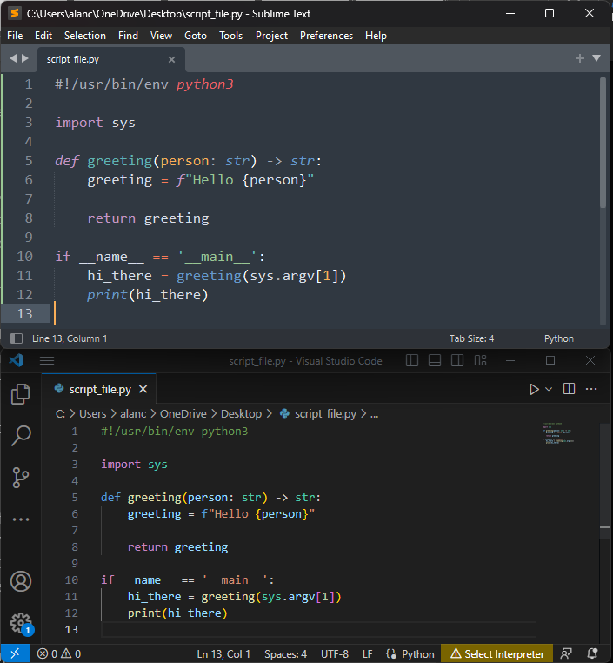
Equipment you will need – Text editor
Use a text editor designed for coding
Monospaced text
Control over line endings and indentation
Syntax is highlighted using different colors
Use whichever you like
Two free options I like:
Sublime Text
VS Code

Slide 13
Exercises/Assessments
Exercise files will be uploaded to Canvas each week
Assignments are set on Tuesdays and due the following Monday (submission after Monday 11:59PM is late!)
Submit a solution to the coding exercises and/or answer a set of questions

Slide 14
Grading
65% is evaluation of your code/assignment (+ some opportunity for extra credit)
25% of your grade is demo
10% is submitting your code/assignment

Slide 15
In-class demonstration
Each week some students will be selected (or volunteer) to either
Demonstrate an example solution to that week’s assignment
Explain what is wrong with a solution that does not work (which they have not seen before)
Field questions (if any) about their explanation (not graded!)
On a week you are not selected, you can volunteer a solution (if yours is different) to satisfy this requirement
A key skill for bioinformaticians is the ability to communicate concepts clearly

Slide 16
Code Evaluation
Coding assignments will be evaluated by the TAs
The TAs will test your code using the following criteria:
Code runs without any errors
Produces the correct output
Finishes in a reasonable amount of time (less than 5 min)
Is not plagiarized
TAs can give you feedback on your assignment, or you can ask questions during discussion sessions

Slide 17
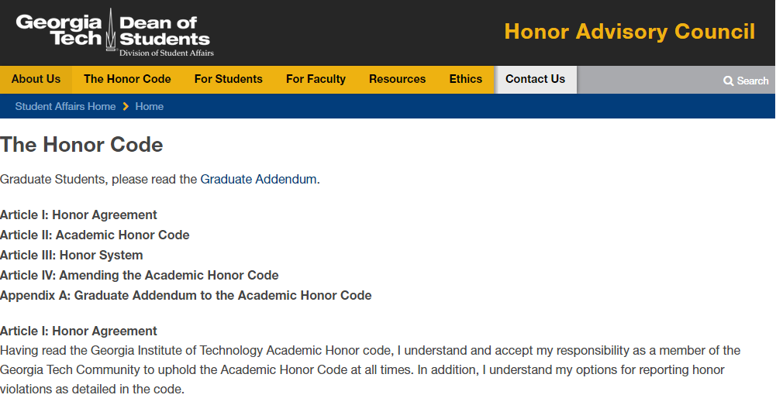
code of ethics

Slide 18
code of ethics
Please look up the honor code, including the Graduate Addendum, at https://osi.gatech.edu/students/honor-code
Any violations to the honor code can result in failing the class and/or expulsion from the institute

Slide 19
To be clear - what’s ok:
Discussing amongst yourself HOW you can approach the solution – not specifics of the code
Helping someone understand a concept by a providing a few examples
Coming to me or the TAs to ask for help, to clarify points of confusion

Slide 20
To be clear - What counts as plagiarism:
Sitting down together and writing the same code (different variable names is still the same code)
Putting assignments up on the web asking for help
And any circumstances that imply that the code is not solely your work

Slide 21
Schedule for today
Introductions
Course structure
Unix systems and the command line
Linux filesystem

Slide 22

Unix operating systems
Unix operating systems (OS) include Linux and MacOS
Unix operating systems are used in bioinformatics because of the command line and shell that comes with these operating systems

Slide 23
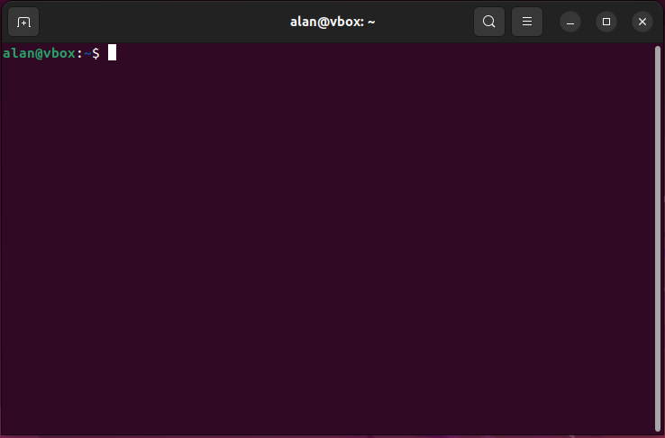
Shell / Command Line interprets text input
The command line and shell are text-only software that allows us to communicate with the computer and issue commands to it
While daunting at first, it quickly becomes intuitive
Linux and MacOS come with many bundled commands
Unix commands typically follow the “Unix philosophy”

Slide 24
The “unix philosophy”
Unix systems follow a modular design, sometimes called the “Unix philosophy”
Each shell command does a small number of things well – few multi-function tools
Commands can be chained together – the output of one becomes input for the next – called a pipeline
command1 | command2 | command3 | command4 | etc.

Slide 25
Command Prompt is where you type commands
Command prompt is where you type commands that are executed by the computer
If you do not see the command prompt, your system is busy executing a command
The specific symbols may differ between OSs, but the function is the same
username@computername:path$ █
Command prompt

Slide 26
commands are interpreted by the shell
The shell takes text input and processes it according to defined syntax rules and keywords
Those keywords and rules constitute a programming language
We will be covering the shell language “Bash” in this course

Slide 27
Bash command syntax
Bash commands follow a fixed syntax
Program [options] [positional_inputs]
The first element specifies the program to execute
Options (or flags) specify settings to control how the program is executed
Positional arguments are typically things like inputs and outputs
Elements of a command are separated by one or more spaces

Slide 28
Schedule for today
Introductions
Introduction to the class and its purpose
Course structure
Unix systems and the command line
Linux filesystem

Slide 29
Special formatting for code in slides
Shading will be used to indicate a word(s) is a command. E.g., command
Inputs will be described using words surrounded by “<>”. These words indicate the nature of inputs. E.g., command <file>
We will add to these style rules later

Slide 30
LiNuX File System
Data are organized into directories (folders) just like Windows/Mac
Starts at a root location “/”
Directories can contain files and other directories

Slide 31
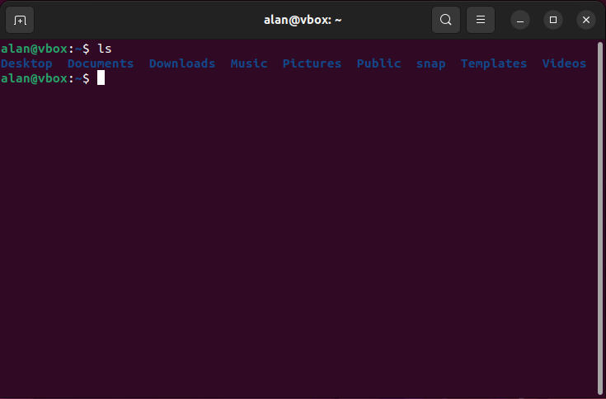
The Ls command lists files and directories
The contents of a directory can be listed using the command ls

Slide 32
Locations in a Linux filesystem are expressed as paths
Locations on a hard drive are described as paths
A path can be thought of as the directories you have to traverse to get to a location
Two kinds:
Relative path (where is it relative to my working dir)
Absolute path (where is it relative to the root dir)

Slide 33
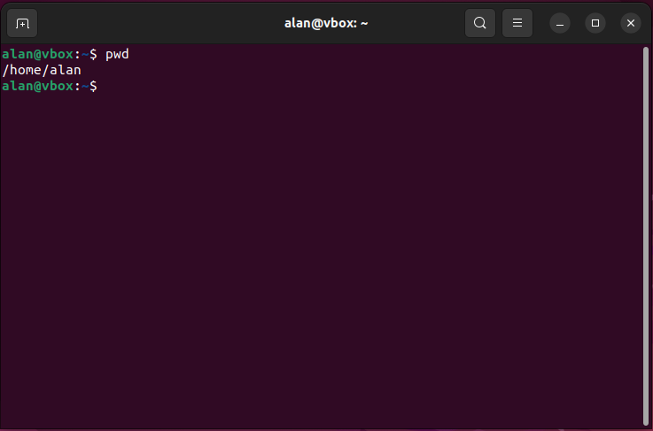
The pwd command prints your working directory
pwd returns the location of your command prompt within your filesystem
Paths beginning with “/” are absolute paths – expressed relative to the root

Slide 34
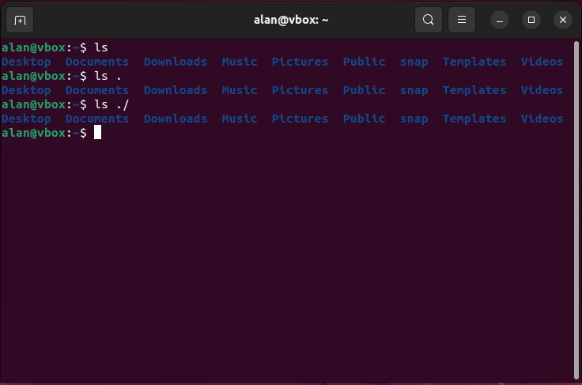
Relative paths are expressed relative to ./
“.” or “./” refers to your current directory
The default behaviour is for ls to list ./
You can list any file or directory using ls <path>

Slide 35
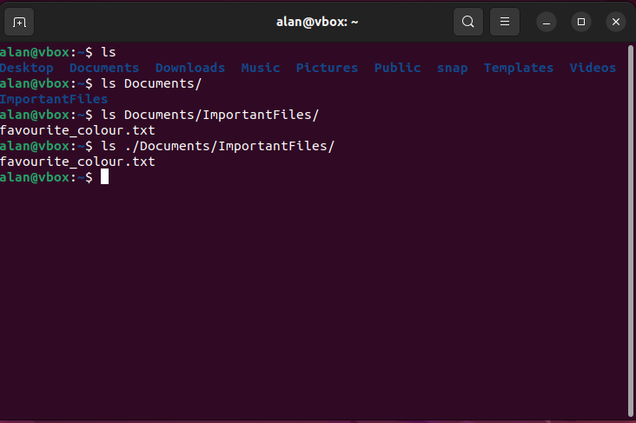
Relative paths: referring to Child directories
Directories in your current directory are expressed as “./directory” or “directory”
The next level down is then “./directory/another_directory”
ls takes a relative or absolute path as positional argument

Slide 36
How do Absolute and relative paths relate?
Question:
My current directory is “/home/alan”
The relative path of a file is “./Documents/ImportantFiles/favourite_colour.txt”
What is the absolute path of “favourite_colour.txt”?
Answer:
Combine the two paths:
“/home/alan/Documents/ImportantFiles/favourite_colour.txt”

Slide 37
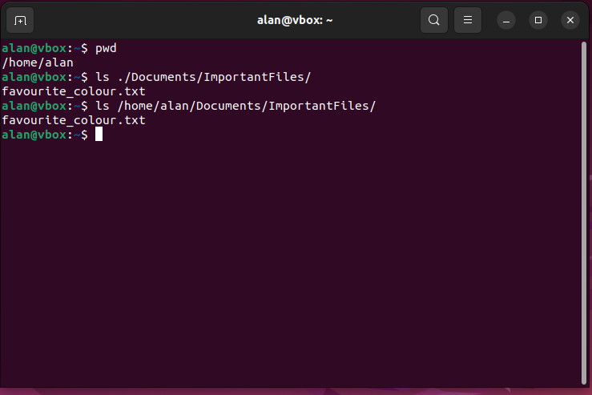
Answer in practice

Slide 38
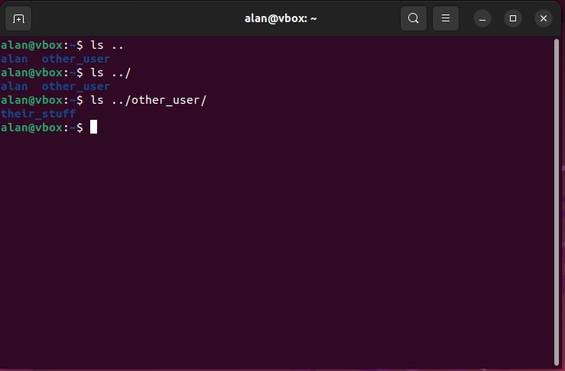
Relative paths: referring to parent directories
Parent directories are referred to using “..” or “../”
A parent of a parent is “../../”
Another directory inside a parent directory is “../Directory”

Slide 39
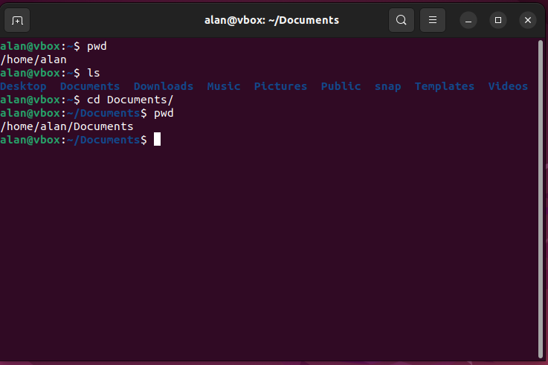
Cd allows you to change directory
cd changes your command prompts working directory
cd takes a relative or absolute path as a positional argument (just like ls)
Tip: cd – changes back to the last directory you were in

Slide 40
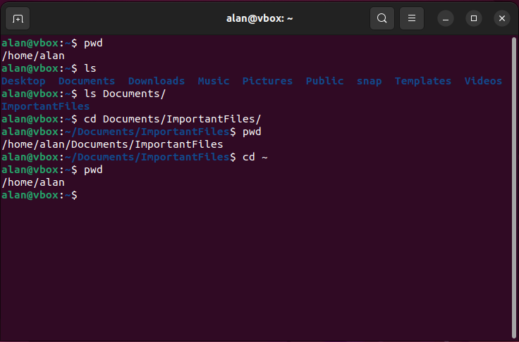
~ refers to your home directory

Slide 41
Your path is displayed in your command prompt

Slide 42
Quick aside: tab-completion
When typing paths, press tab to automatically complete the dir or filename you are typing
Press once to complete a name if there’s no ambiguity what you are typing
Press twice to list all names you could be typing in the current dir
E.g., in a dir with two files: “design.txt” and “data.txt”, “d” is not enough to tab-complete, but “de” or “da” is.

Slide 43
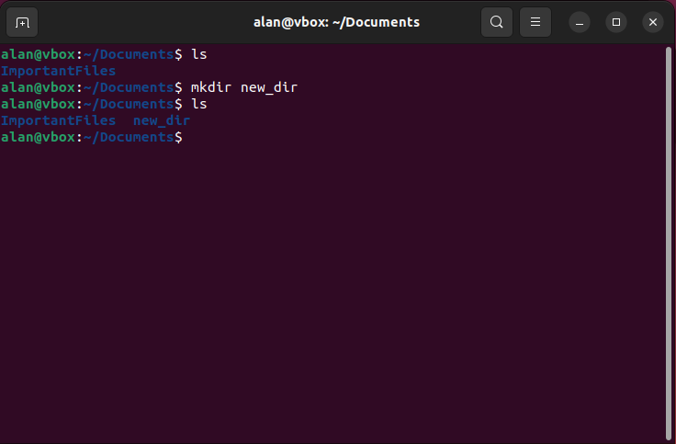
Mkdir makes a directory

Slide 44
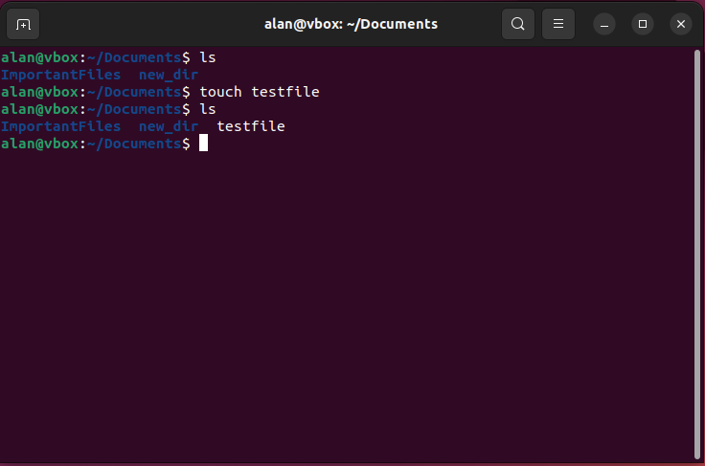
Touch creates an empty file

Slide 45
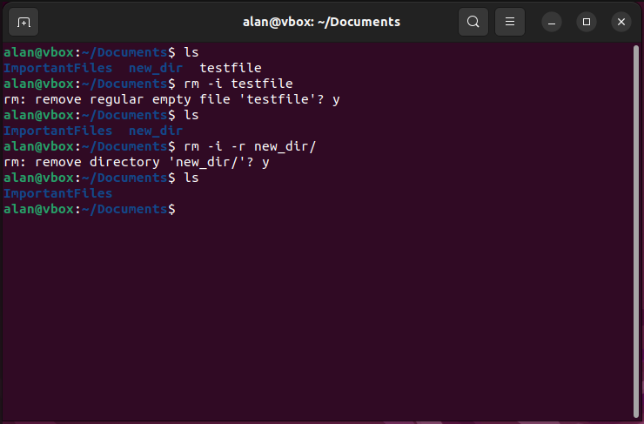
Rm removes files and directories
BE VERY CAREFUL!!! Deleted files and directories are gone forever!

Slide 46
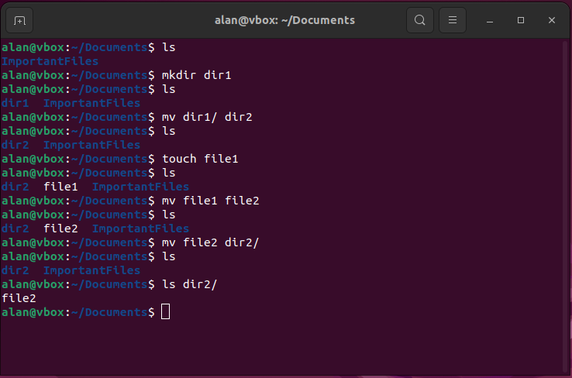
Mv moves or renames files and directories

Slide 47
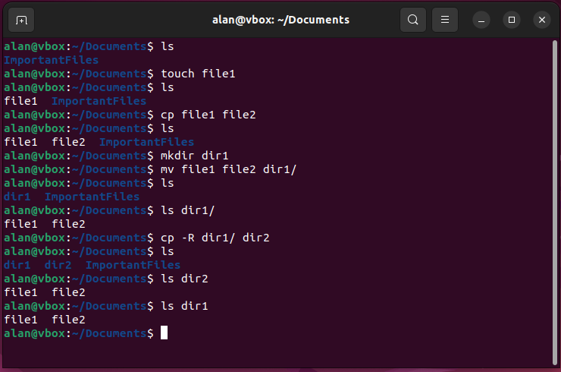
Cp copies files and directories

Slide 48
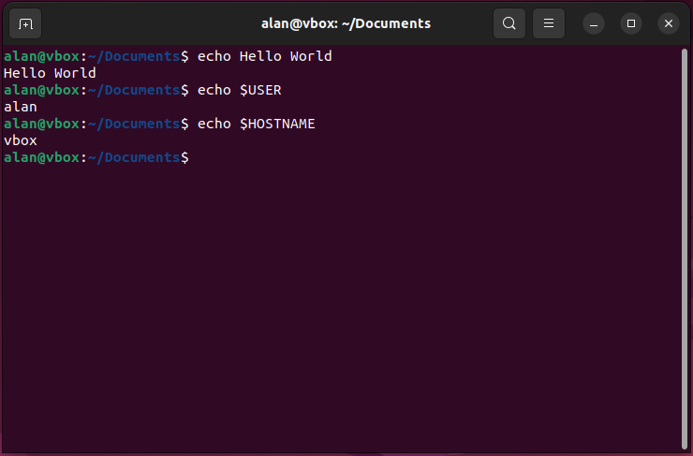
Echo prints to your stdout
In its simplest usage, echo repeats what you say back to you (i.e., echoes it)
echo can also print the contents of variables (we’ll cover this later)
We’ll be using it a lot in future

Slide 49
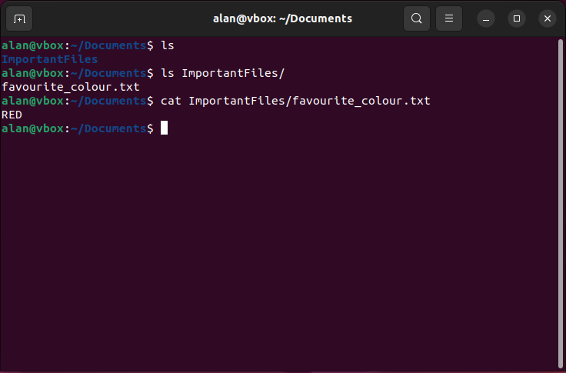
Cat concatenates files and prints the contents
cat can read one or more files and return their contents in one go
Used as the go-to command to get the contents of files for downstream use or quickly view file contents

Slide 50
Information is passed to and from processes
Your command prompt has 3 streams of information which can be passed between processes:
stdin: the input stream of a process
stdout: the output stream of a process
stderr: a second output stream for diagnostic or error information
stdout prints to your terminal unless redirected
Note: stdin is explicitly referred to as “-”
Stdout (1)
Process
stdin
Stderr (2)

Slide 51
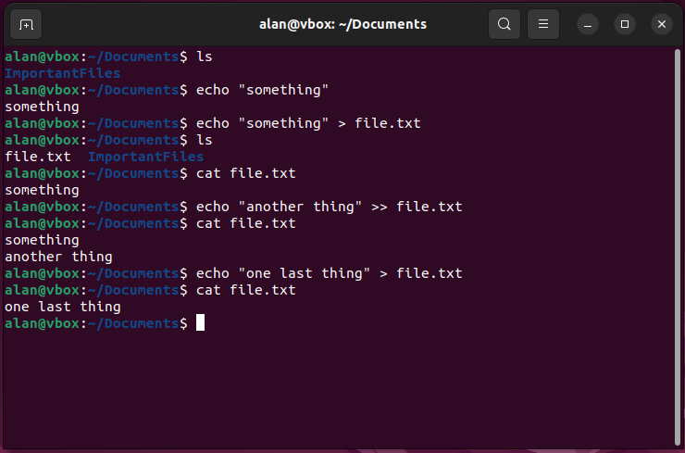
How can you redirect stdout to a file?
Bash has two stdout redirects:
> and >> both redirect to a file
| redirects to the stdin of another process (Thursday’s lecture)
> overwrites an existing file (creates the file if it didn’t exist)
>> appends to an existing file (creates the file if it didn’t exist)
Note: > is equivalent to 1> (i.e., stdout redirect). To redirect stderr use 2>

Slide 52
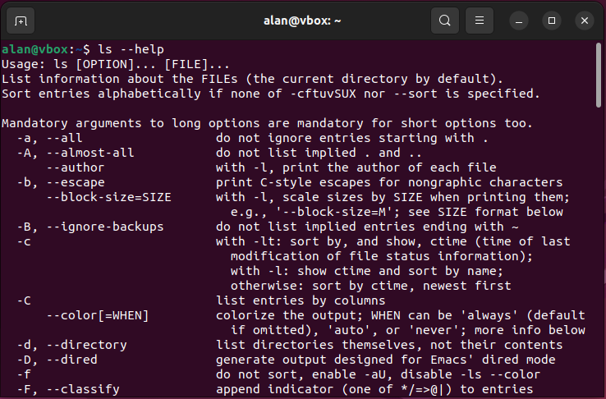
Linux commands have documentation
By convention, a help message is printed when run with either:
-h
--help
-help
Note: usually “-” is used for short options (-h), “--” for long options (--help)
https://explainshell.com/

Slide 53
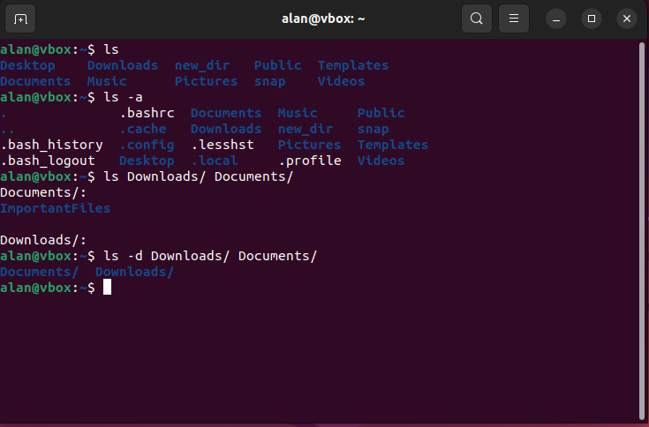
Options change the way commands behave
Options can be short or long (e.g., -a, --all)
Options can sometimes take inputs

Slide 54
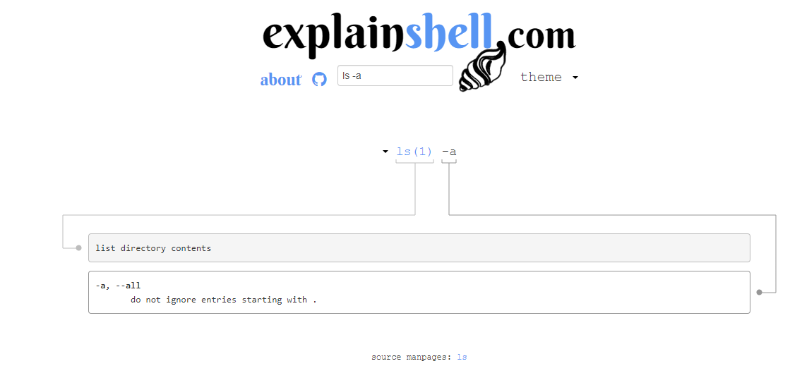
Explainshell can be clearer

Slide 55
Command usage syntax
Usage of commands is described using symbols and words
Commands often follow the following convention:
foo [-abBc] [-d | -e] [-f file] [-n [number]] input1 [input2 …]
“[]” indicates optional inputs. No “[]” means required
“-xyz” is a list of options that do not take input
Note: sometimes “<>” are used to indicate the input’s nature (e.g., “<file>” or “<number>”)
Option that
takes input
This input is optional
Any number of inputs can be given
either

Slide 56
End of Lesson

Slide 57
Handy keyboard shortcuts
Keyboard / mouse input | Action
Ctrl+Shift+c | Copy selected text
Ctrl+Shift+v | Paste copied text at cursor
Ctrl+e / end | Position cursor at end of line
Ctrl+a / home | Position cursor at beginning of line
Ctrl+y | Insert deleted text
Left | Move cursor back by one position
Right | Move cursor forward by one position
Alt+b | Jump back by one word
Alt+f | Jump forward by one word
Ctrl+w / Alt+backspace | Delete word to the left of cursor
Alt+d / Ctrl+delete | Delete word right of cursor
Ctrl+u | Delete all text left of cursor
Ctrl+k | Delete all text right of cursor
Up | Previous command
Down | Next command (if any)

Slide 58
Linux File System

